Slide 1

LU3 Unsupervised Machine Learning
Unsupervised learning finds patterns in data without predefined labels.
P131

Slide 2
Unsupervised Learning
Unsupervised learning is all of machine learning where there is no known output.
It is not trained on structured data to make predictions or classifications.
The learning algorithm is just shown the input data and asked to extract knowledge from this data.

Slide 3
Uses of Unsupervised learning
Customer Segmentation: E-commerce platforms use clustering to group customers based on purchasing behavior, helping with targeted marketing and recommendation systems.
Anomaly Detection: Banks use unsupervised learning to detect fraudulent transactions by identifying unusual spending patterns.
Medical Diagnosis: Clustering helps in identifying disease subtypes in genomics and patient data for personalized medicine.
Image Segmentation: Used in computer vision for self-driving cars to distinguish between different objects on the road.
Document Grouping: Search engines categorize web pages based on content similarity, improving search relevance and recommendations.

Slide 4
Types of Unsupervised learning
Unsupervised transformations
Dimensionality Reduction: The transformation of a dataset into a representation which may be easier for humans or other ML algorithms to understand.
Topic Extraction: Finding the main features in a dataset, the “topics” that make up the data.
Clustering: The grouping of data into partitions that share features or are similar in some way.

Slide 5
Your turn
Netflix Movie Recommendations
Netflix suggests movies based on a user’s past viewing history and similar user preferences.
(Answer: Unsupervised Learning – Clustering & Collaborative Filtering)
Spam Email Detection
An email service automatically filters out spam emails based on past labeled examples.
(Answer: Supervised Learning – Classification)
Self-Driving Cars
A self-driving car learns to navigate roads by interacting with the environment and adjusting based on success or failure.
(Answer: Reinforcement Learning – Decision Making & Control)
Customer Segmentation for Marketing
A company groups customers into segments based on purchasing behavior to personalize ads.
(Answer: Unsupervised Learning – Clustering)
Credit Card Fraud Detection
The system identifies fraudulent transactions based on historical labeled fraud cases.
(Answer: Supervised Learning – Anomaly Detection & Classification)
Handwriting Recognition (Digit Recognition)
A postal system scans handwritten zip codes and converts them into digital text.
(Answer: Supervised Learning – Classification, Neural Networks)
Google Translate
The system learns to translate between different languages without labeled translations.
(Answer: Unsupervised Learning – Deep Learning, Neural Networks, Word Embeddings)
Stock Market Price Prediction
A model predicts future stock prices based on historical data and trends.
(Answer: Supervised Learning – Regression)
AI Beating Humans in Chess
An AI learns the best chess strategies by playing millions of games and improving over time.
(Answer: Reinforcement Learning – Game Playing, AlphaZero)
Facial Recognition on Phones
Your phone unlocks when it recognizes your face, learning from stored face images.
(Answer: Supervised Learning – Classification, Deep Learning)

Slide 6
What is Reinforcement Learning (RL)?
Reinforcement Learning (RL) is a type of machine learning where an agent learns to make decisions by interacting with an environment to maximize a reward. Instead of learning from labeled data (like in supervised learning) or discovering hidden patterns (like in unsupervised learning), the agent learns through trial and error, receiving rewards or penalties for its actions.

Slide 7
Clustering vs Transforming
Clustering:
Groups similar data points into clusters.
Common algorithms: K-Means, Hierarchical, DBSCAN.
Used for segmentation and anomaly detection.
Transformations:
Modify the data representation without explicit grouping.
Common techniques: PCA (Principal Component Analysis), t-SNE, Autoencoders.
Used for feature extraction, dimensionality reduction, visualization.
Key Difference:
Clustering assigns labels to groups, while transformations restructure data for better analysis.

Slide 8
Challenges in Unsupervised Learning
No Ground Truth
No predefined labels to evaluate results.
Requires heuristic or external validation (e.g., silhouette score for clustering).
High Dimensionality
Curse of dimensionality affects distance-based algorithms.
Dimensionality reduction methods (e.g., PCA) are often required.
Choosing the Right Algorithm
Different clustering methods work best for different data structures.
Hyperparameter tuning (e.g., number of clusters in K-Means) is difficult.
Feature Scaling Issues
Clustering algorithms like K-Means are sensitive to scaling.
Proper pre-processing (e.g., normalization, standardization) is required.
Overfitting in High Complexity Models
Some unsupervised methods may capture noise instead of meaningful patterns.
Requires careful model selection and validation.

Slide 9
Preprocessing and Scaling
Why it's important: In unsupervised learning, particularly clustering (e.g., K-means), distance metrics like Euclidean distance are often used. If features are on different scales (e.g., age vs. income), the model might overemphasize some features.
How it works:
Normalization: Scaling the data to a common range, typically [0, 1] (Min-Max Scaling).
Standardization: Transforming the data to have a mean of 0 and a standard deviation of 1 (Z-score normalization), which is important when the features have varying units or scales.

Slide 10
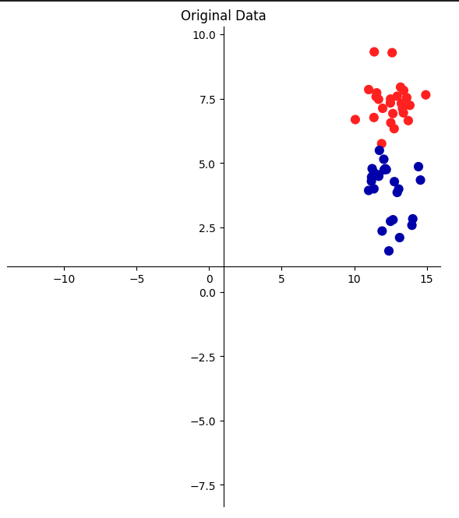
mglearn.plots.plot_scaling()

Slide 11
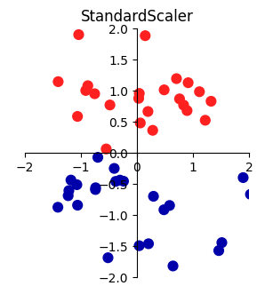
Standard Scaler
Ensures that for each feature the mean is 0 and the variance is 1, bringing all features to the same magnitude.
Does not ensure any particular minimum and maximum values for the features.

Slide 12
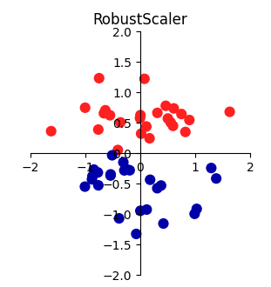
Robust Scaler
Similar to the Standard Scaler in that it ensures statistical properties for each feature that guarantee that they are on the same scale.
Uses the median and quartiles, instead of mean and variance.
Ignores data points that are very different from the rest (outliers).

Slide 13
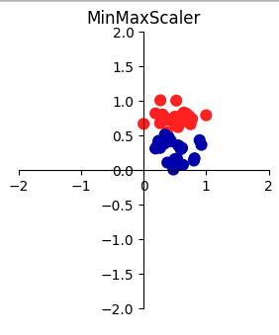
Min Max Scaler
Shifts the data such that all features are exactly between 0 and 1.
All data is therefore contained between 0 and 1 on both axes.

Slide 14
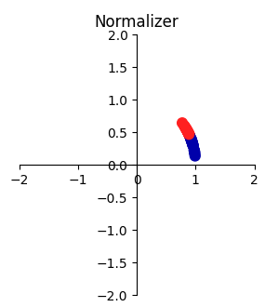
Normalizer
Scales each data point such that the feature vector has a Euclidean length of 1.
In other words, it projects a data point on the circle (or sphere, in the case of higher dimensions) with a radius of 1.
This means every data point is scaled by a different number (by the inverse of its length).

Slide 15
Activity
Page 134-140
Use scaling on an SVM model to see the difference in accuracy.
Tell me why?

